Slide 1



PROJECT - PHASE 1 | BATCH-9
Smart Grain Storage Condition
Monitoring and Spoilage Risk
Prediction for PDS using Al and loT
A low.cost, realtime loT ond Machine Learning system to predlict groin spoilage risk before it happens.
Submitted by
Gokula kannaan M (24619113)
Umesh R (24619161)
Vignesh S (24619157)
project Guide
Ms. S. J.kavitha

Slide 2
PROBLEM STATEMENT
Public Distribution System (PDS) warehouses store essential food grains such as rice, wheat, and dhal for long periods before distribution to the public. During storage, environmental factors such as high temperature, excessive humidity, increased grain moisture, and poor air quality can lead to fungal growth, insect infestation, bad odor, and grain spoilage. Existing storage systems mainly rely on manual inspection, which is time-consuming and cannot continuously monitor storage conditions. This may result in food wastage, reduced grain quality, and economic loss.
To overcome these challenges, a low-cost AI and IoT-based smart monitoring system is proposed. The system continuously monitors environmental conditions inside a PDS grain warehouse and predicts the storage condition as Safe, Moderate Risk, or High Risk using AI. Real-time alerts are displayed through an IoT dashboard, helping warehouse staff take preventive action before grain spoilage occurs.

Slide 3
OBJECTIVES
Develop an AI and IoT-based smart grain
storage monitoring system for PDS warehouses.
Specific Objectives:
  Monitor temperature inside the grain storage warehouse.
  Monitor humidity continuously.
  Measure grain moisture level.
  Detect harmful gases using MQ135 sensor.
  Send sensor data to an IoT dashboard.
  Predict grain storage condition using AI.
  Generate Safe, Moderate Risk, and High Risk alerts.
  Reduce grain spoilage and food wastage in PDS warehouses.

Slide 4
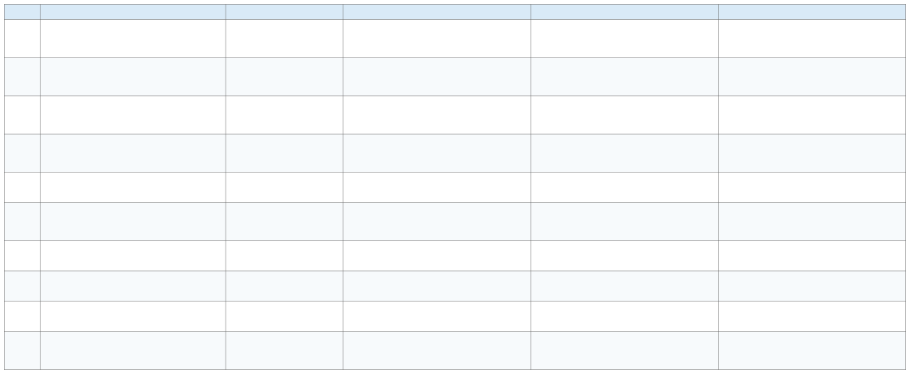
LITERATURE REVIEW
S.No.
Title
Author
Methodology
Addresses
Limitation
1
Applications of new technologies for monitoring and predicting grains quality stored: Sensors, Internet of Things, and Artificial Intelligence
Everton Lutz; Paulo Carteri Coradi (2022)
Review of sensor-based monitoring, IoT/WSN architectures and machine-learning approaches for stored-grain quality. Variables include moisture, temperature, relative humidity and intergranular CO.
IoT warehouse monitoring using sensor nodes, PIC microcontroller, GSM/cloud connectivity and mobile/SMS reporting. Monitors grain level, temperature, humidity,
vibration, CO, motion and smoke.
Wireless sensor network and IoT platform for real-time temperature and relative-humidity monitoring, with neural-network models predicting physical, physicochemical and microbiological quality of corn.
Wireless sensor network + IoT platform for real-time temperature and relative-humidity monitoring; artificial neural networks predict grain quality under different moisture, temperature and packaging conditions.
Monitors temperature, relative humidity and CO using
sensors; artificial neural networks and multiple linear
regression predict dry-matter loss in stored wheat.
Review of IoT applications for food-grain storage, including real-time monitoring, early warning, environmental control, inventory, traceability and predictive analytics in the Indian context.
Compact Convolutional Transformer (CCT) classifies wheat as healthy, incipient or contaminated using CO respiration and visual mold information. Reported accuracy: 83.33%.
Uses 2.4 GHz and 868 MHz wireless/RF measurements with ensemble ML to estimate rice moisture content and localize
wet spots. Reported ensemble accuracy is about 94.8%.
Design-Based Research prototype using ESP32, DHT22 temperature/humidity sensors, LDR, soil-moisture sensing and cloud data transmission with early warnings.
Monitors temperature, relative humidity and CO during transport, drying and storage. Uses regression, artificial neural networks, decision tree and random forest models to predict grain quality.
Explains how real-time sensing and ML can support early detection of deterioration and better storage decisions. Provides the technical basis for combining sensors, IoT and AI in grain storage.
Supports remote warehouse monitoring and reduces dependence on manual inspection. Covers multiple physical and environmental conditions linked to grain loss.
Review study rather than a field-validated PDS system. No single integrated spoilage-risk model specifically designed for Indian PDS warehouses.
2
Automated food grain monitoring system for warehouse using IOT
Lydia J.; Leones Sherwin Vimalraj S.; Monisha R.; R. Murugan (2022)
Mainly threshold-based monitoring; predictive AI/spoilage-risk estimation is limited. Large-scale, long-duration PDS validation is absent.
3
Prototype wireless sensor network and Internet of
Things platform for real-time monitoring of intergranular equilibrium moisture content and predict the quality
corn stored in silos bags
Real-time equilibrium moisture content monitoring to predict grain quality of corn stored in silo and raffia bags
Paulo Carteri Coradi et al. (2022)
Connects environmental measurements with grain-quality prediction and demonstrates continuous monitoring instead of occasional sampling.
Focused on corn in bag silos and a limited storage setup. Needs validation across PDS grains, warehouse layouts and Indian climatic conditions.
4
Everton Lutz et al. (2022)
Shows that equilibrium moisture content can be an important indicator of quality deterioration and supports real-time prediction.
Controlled experimental conditions and mainly corn-focused. A multi-grain, real-warehouse dataset would strengthen a PDS spoilage model.
5
Monitoring of intergranular variables for predicting technical breakage of wheat grains stored in vertical silos
Smart food grain storage system using Internet of Things (IoT): A Review
Marisa Menezes Leal et al. (2023)
Shows that changes in intergranular temperature, humidity and CO can provide early information about grain-quality changes and support predictive decisions.
Directly connects IoT-based storage technology with Indian food security and grain-storage challenges such as spoilage, mold and insect infestation.
Focuses on vertical-silo wheat storage and dry-matter loss rather than full spoilage classification. Pest, fungal and operational variables are not fully integrated.
Review paper; does not experimentally validate a complete AI + IoT PDS warehouse system or quantify predictive performance on PDS datasets.
6
Supriya Priyadarsani; Asit Kumar Pradhan; Prakash Chandra Jena (2023)
7
Predicting early mycotoxin contamination in stored wheat using machine learning
Yonggik Kim; Seokho Kang; Oladayo Solomon Ajani; Rammohan Mallipeddi; Yushin Ha (2024)
Noraini Azmi et al. (2024)
Demonstrates AI-based early contamination classification and the value of distinguishing early-stage spoilage from already contaminated grain.
Supports non-invasive moisture estimation and localization of potential wet/spoilage areas in stored rice.
Uses a relatively small laboratory image dataset and controlled conditions. More diverse field data and sensor/IoT integration are needed for PDS deployment.
Testbed-based validation. Large heterogeneous PDS warehouses, different grain types and changing RF environments need further validation.
Mainly monitors conditions; automatic control and mobile integration were future improvements. AI-based spoilage-risk prediction is not the main focus.
Focused on corn and a specific workflow. PDS implementation needs continuous warehouse data, multi-grain validation,
alerts, traceability and operational integration.
8
Integration of dual band radio waves and ensemble-based approach for rice moisture content determination and localisation
Prototype of Smart Grain Storage Based Internet of Things
9
Wahyu Adi Pratama; Nurchim; Bondan W. Pamekas (2024)
Provides a low-cost IoT architecture for real-time grain-storage monitoring and early warning.
10
Monitoring and predicting corn grain quality on the transport and post-harvest operations in storage units using sensors and machine learning models
Dágila Melo Rodrigues et al. (2024)
Integrates sensor measurements across post-harvest stages and compares ML models for predicting quality changes.

Slide 5
RESEARCH GAP
Existing journal papers mainly focus on maize grain monitoring, anomaly detection, or advanced research technologies such as Electronic Nose systems. Most of these works do not provide a low-cost AI-enabled monitoring solution for Public Distribution System (PDS) warehouses. Our proposed project fills this gap by developing an ESP32-based IoT prototype that monitors temperature, humidity, grain moisture, and air quality, while an AI model predicts the storage condition as Safe, Moderate Risk, or High Risk and displays real-time alerts on an IoT dashboard. This makes the proposed system practical, affordable, and suitable for PDS warehouse management.

Slide 6
EXISTING SYSTEM
The existing grain storage system mainly depends on manual inspection and traditional monitoring methods. Farmers and warehouse workers check the grain condition periodically, which is time-consuming and may not detect spoilage at an early stage.
  Grain quality is monitored manually by workers.
  Temperature and humidity are not monitored continuously.
  Spoilage gases cannot be detected in real time.
  High moisture levels may lead to fungal growth and grain damage.
  There is no automatic alert or prediction system.
  Traditional methods increase the risk of grain spoilage and food loss.

Slide 7
PROPOSED METHODOLOGY
Stage 1 – Grain Storage Monitoring
In PDS warehouses, the storage conditions of rice, wheat, and pulses are continuously monitored to maintain grain quality and safety.
Stage 2 – Sensor Data Collection
  DHT22: Measures temperature and humidity.
  Moisture Sensor: Measures grain moisture content.
  MQ135: Detects air quality and harmful gases.
Stage 3 – ESP32 Processing
The ESP32 microcontroller collects data from all sensors, performs initial processing and filtering, and prepares the data for transmission.
Stage 4 – IoT Data Transmission
The processed sensor data is transmitted through Wi-Fi to the cloud server and monitoring dashboard for real-time access.
Stage 5 – AI Analysis
A Python-based AI/ML model analyzes the incoming sensor data and identifies patterns associated with grain deterioration and spoilage.
Stage 6 – Spoilage Risk Prediction
The AI model classifies the storage condition into three risk levels:
  Safe – Normal storage condition
  Moderate Risk – Attention required
  High Risk – Immediate action required
Stage 7 – Alert System
Based on the predicted risk level, alerts are generated through:
  LCD Display
  LED Indicator
  Buzzer Alarm
  Web Dashboard / Mobile Application
This methodology enables real-time monitoring, early spoilage-risk detection, timely alerts, and improved grain-storage management in PDS warehouses.

Slide 8
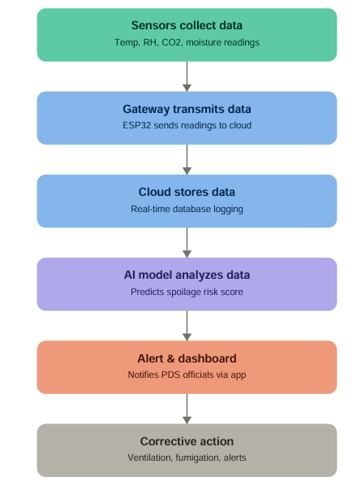
SYSTEM ARCHITECTURE

Slide 9
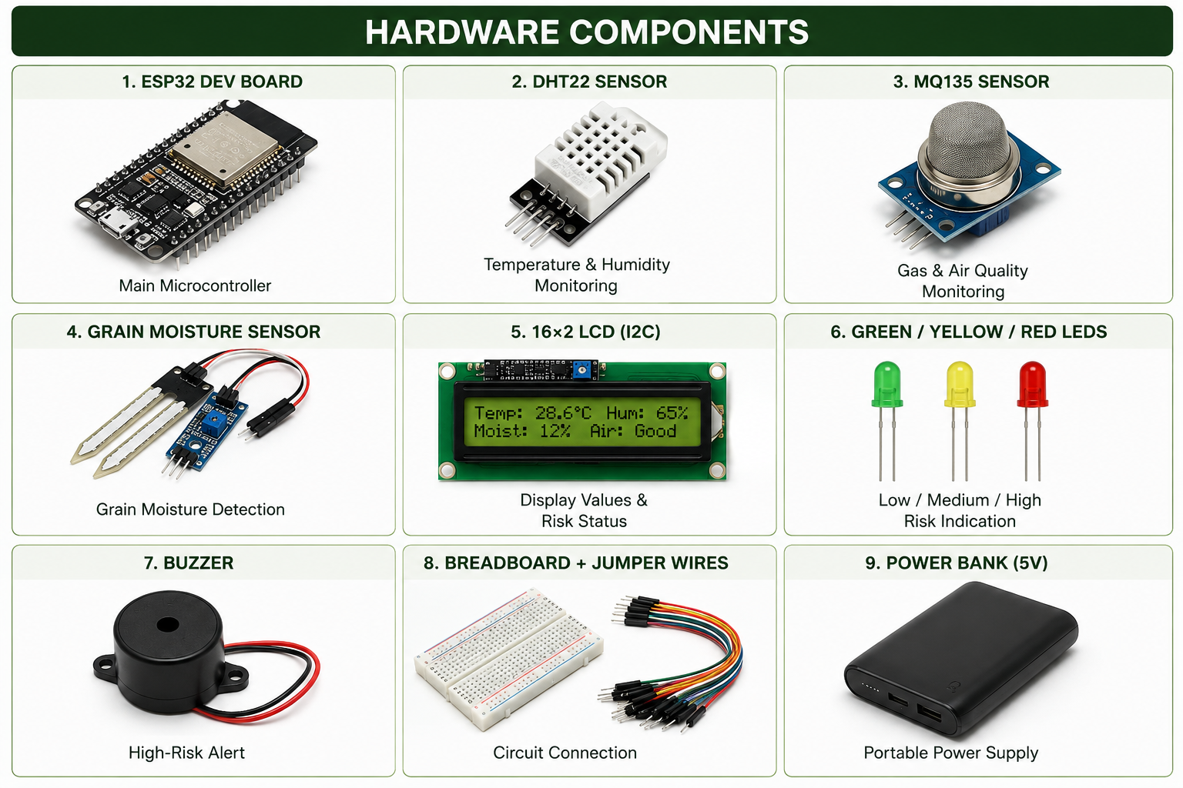
HARDWARE REQUIREMENTS

Slide 10
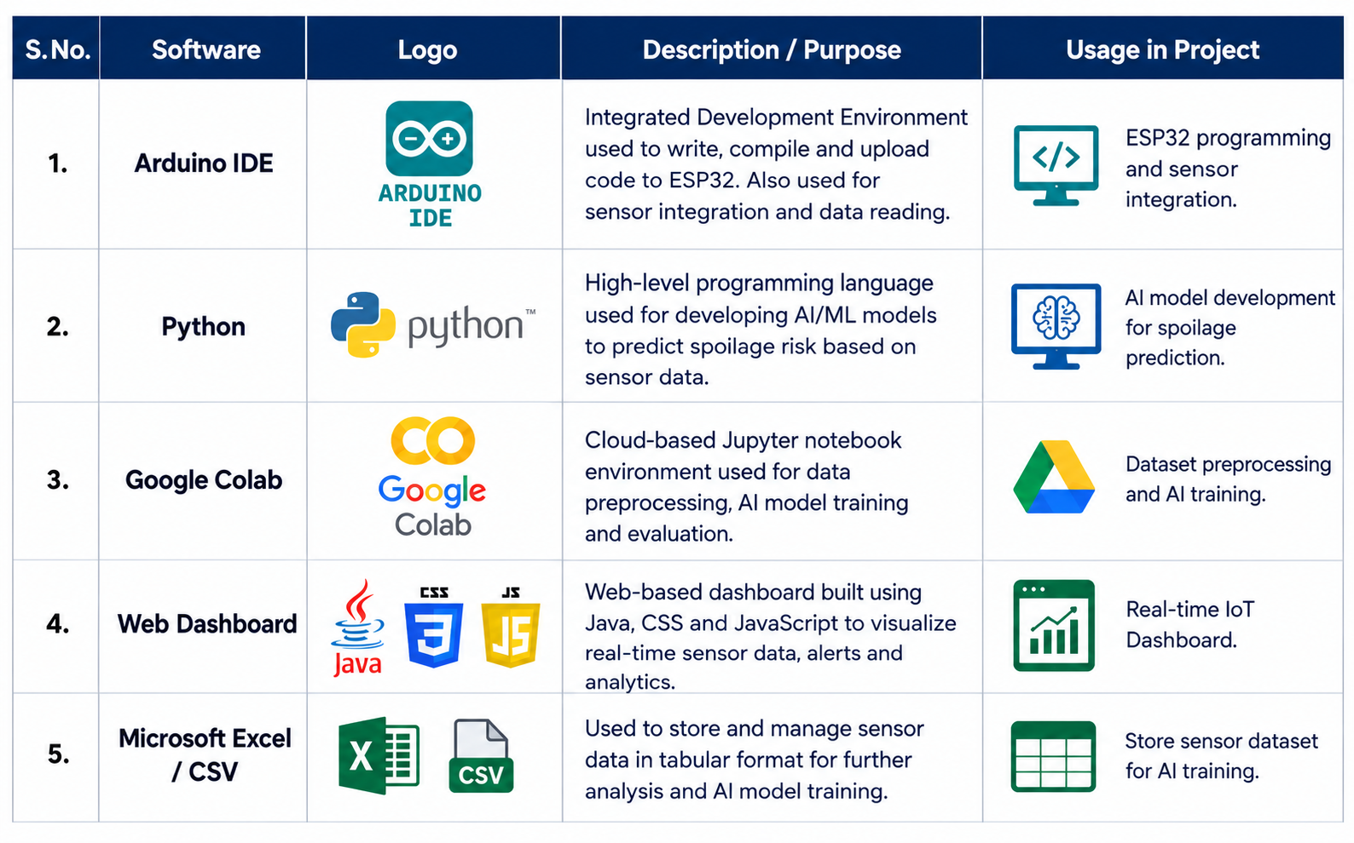
TECHNOLOGY USED

Slide 11
DATA SET
  The dataset contains Temperature, Humidity, Gas, and Grain Moisture sensor values collected from grain storage conditions.
  Each record is labeled as Safe, Warning, or Danger based on grain quality.
  The dataset is used to train the AI model to predict the risk of grain spoilage.
  Live sensor data from the ESP32 is compared with the trained dataset for prediction.
  The AI model provides recommendations such as Dry Grains, Improve Ventilation, or Inspect Storage.

Slide 12
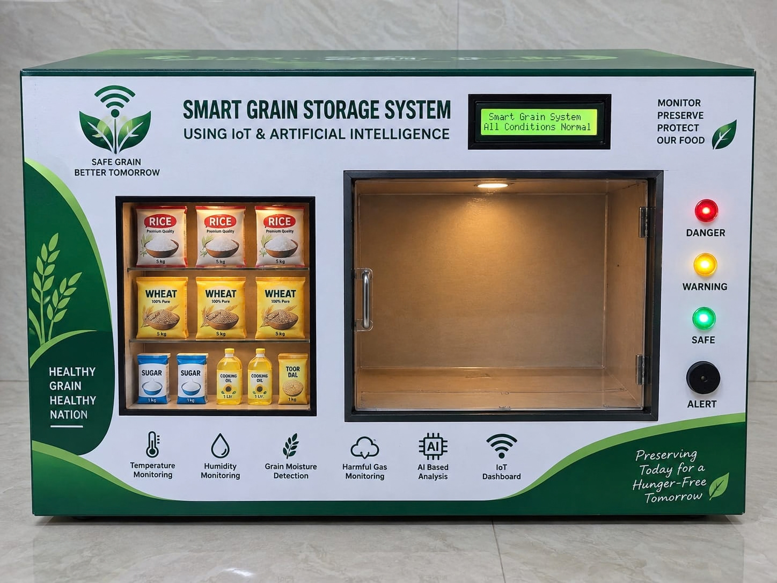
IMPLEMENTATION

Slide 13
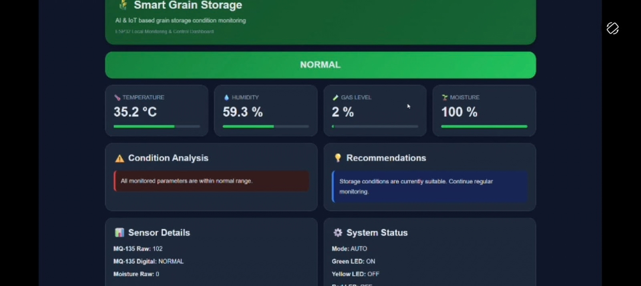
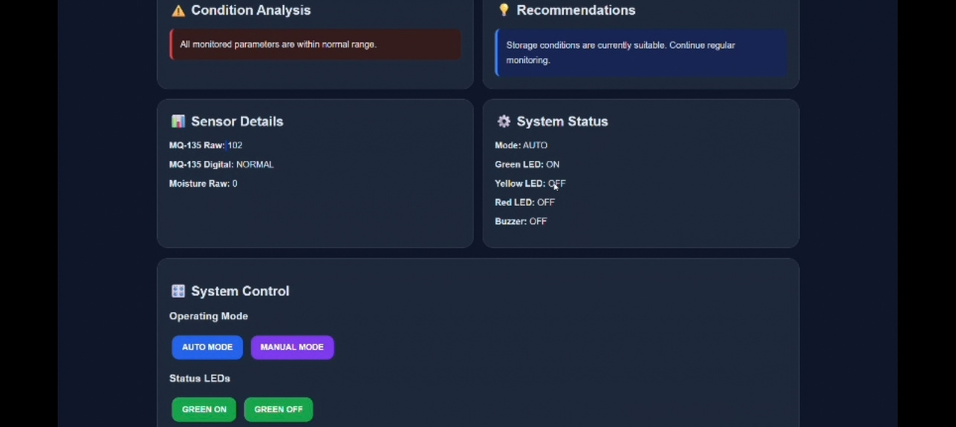
RESULTS

Slide 14
FUTURE ENCHANCEMENT
Our Smart Grain Storage System can be enhanced with additional smart features to improve monitoring and warehouse management.
  Develop a mobile application for real-time monitoring from anywhere.
  Store sensor data in cloud storage for long-term analysis and report generation.
  Add GSM/SMS and notification alerts for farmers and warehouse managers.
  Integrate a camera-based grain inspection system to detect fungal growth and damaged grains.
  Monitor multiple grain storage units using a single dashboard.
  Add data history and graphical reports to analyze storage conditions over time.

Slide 15
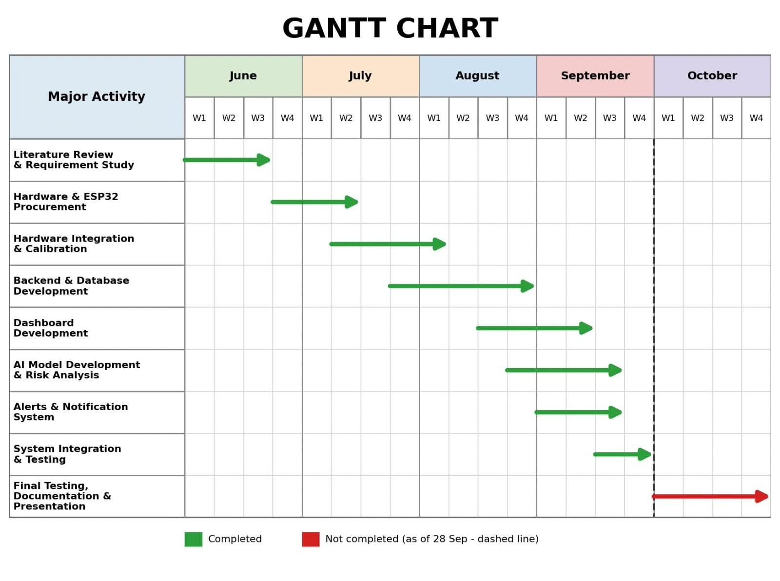
GANTT CHART

Slide 16
THANK YOU

